Slide 1
BILHPN WellSense MassHealth ACO Tiering Office Hours
October 26, 2023

Slide 2
BILHPN MassHealth ACO Office Hours
New BILHPN-led series aimed at providing ACO updates and a forum to discuss best practices
Sub-capitation and tiering updates
MassHealth Quality Measures
MassHealth Health Equity
This will complement updates shared within the monthly BILHPN ACO Newsletters and tiering email updates
Notes:
The purpose of the MH office hours is to provide a forum for BILHPN/WellSense to share MH Tiering related updates and have participating sites ask questions and share best practices with one another.
Today we will be reviewing take aways from the MH 2023 Audit and expectations for the 2024 audit cycle.

Slide 3
Contents
2023 Tier Compliance Audit Takeaways
Tiering – Looking Ahead to 2024
Tiering Resources
Office Hours
Q&A

Slide 4
Tier Compliance Audit Overview

Slide 5
2023 Tier Audit Timeline
4/1: BILHPN WellSense MassHealth ACO went live
7/1: Expectation that tier requirements would be in place for the sub-capitation program by this date
8/31: Deadline for first primary care sub-capitation audit cycle
MassHealth Sub-Capitation Program Audit
MassHealth notified practices of their selection on 7/20
Practices were given 6 weeks to compile tier compliance evidence by 8/31
Practice submitted online form and received
confirmation of audit completion
Notes:
Practices were notified of their selection for the primary care sub-capitation tier audit in late summer.
MH asked practices to confirm practice mainly serves adults, pediatrics, or both AND confirm tier attestation
Upon receipt of the tier attestation email, practice representatives were provided with a PDF version of the submission form to review and asked to compile all requested documentation within a 6-week period

Slide 6
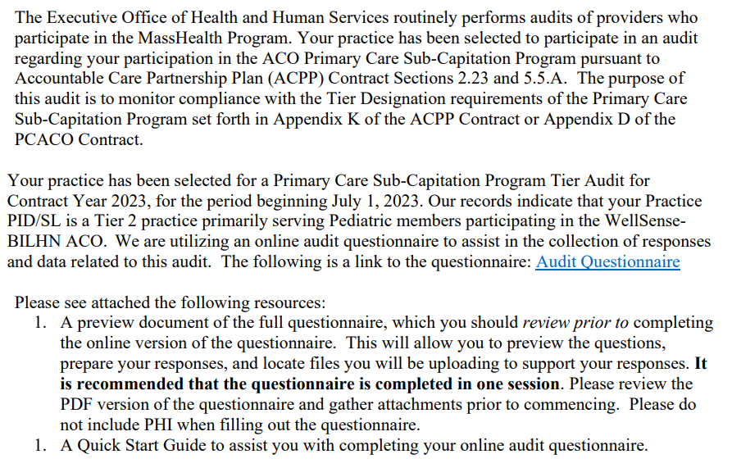
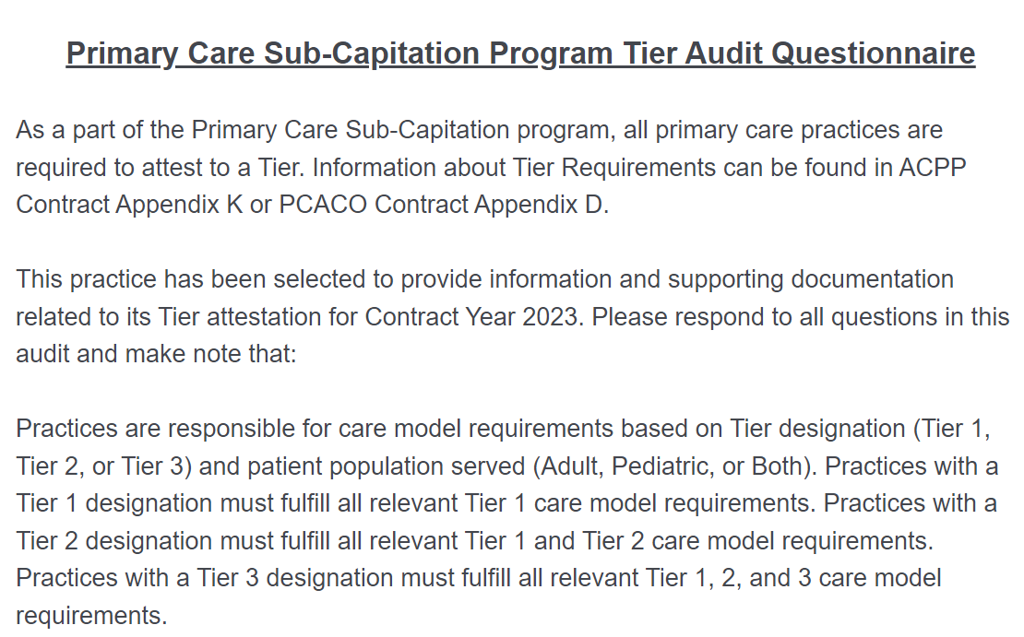
Audit Format
MassHealth provided a copy of the questionnaire to practices at the time of their selection for audit
Practices were asked to review the questionnaire, compile evidence, and complete the submission to the online portal in one sitting

Slide 7
Audit Responses
Audit Prompt | Sample Response
Attest Yes or No to meeting the requirement | YES, our practice provides BH referrals with bi-directional communication (Tier 1)
Upload a blank copy of screener or type the name of standardized screener | Depression Screener: PHQ-9 (Tier 1)
Submit a resume or provide a brief narrative describing the staff member's relevant experience | Staff with children, youth, and family-specific experience: Attach Jane Doe's resume (Tier 2)
Submit the Name, License Type, License Number, and FTE status of the staff member(s) that fulfill this requirement. | Independent Consulting BH Clinician with Prescribing Capability: Jane Doe, MD, 1234, .3FTE (Tier 3)

Slide 8
BILHPN Support
BILHPN compiled all prompts in the 2023 MH Tiering Prompts​.xslx
This file combines the information held within the tiering tracking grids and the state's audit questionnaire
During the 6-week notice period, BILHPN Tiering Support Specialists met with Quality Leads and Project Managers to review Tracking Grids, gathered compliance documentation, and assist in compiling evidence ahead of the one-time submission.
BILHPN recommends using the 2023 MH Tiering Prompts file and an accompanying MH Tiering Folder to store your practice’s documented evidence for each Tier Requirement
*

Slide 9
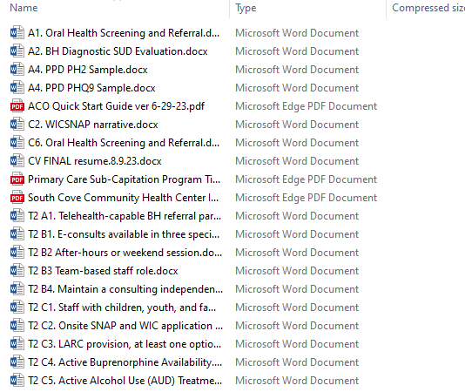
Tiering Testimonials: HCA & South Cove, Holmes St.
" The biggest piece of submitting for the audit that I wasn’t expecting was that it seemed like for the questions that were providing information rather than evidence, they gave space to upload documents and it seemed as though the idea was to upload a document vs use the space provided for additional comments. It was a bit unclear to me which was preferred. I ended up doing a mix of both depending on how much information was needed. I intended to go back and make it all uniform and just upload documents, but once you hit the final continue button your survey submits without super clear indication (from what I can remember) that you’ve reached the end and are submitting." - HCA
"The initial questionnaire that was provided by MassHealth was missing some questions in the Tier 2 section. It will be helpful to request a complete questionnaire from MassHealth." - South Cove
Example: South Cove Tier Evidence folder

Slide 10
Planning for 2024

Slide 11
Changing from Tier-to-Tier Designation
Practices maintaining their Tier 1 designation | Practices moving from Tier 1 → 2 | Practices maintaining their Tier 2 or 3 designation
There have been no changes to the tier requirements at this designation. Any practice may be selected for an audit in 2024. | Practices changing tier designations must continue to meet all Tier 1 requirements for the population they serve in addition to Tier 2 requirements. | There have been no changes to the tier requirements at this designation. Any practice may be selected for an audit in 2024.
Practices that are population specific will only be asked to provide evidence for the requirements specific to the populations they serve
Family Medicine practices will be asked to provide evidence for adult and pediatric requirements.
Pediatric and adult practices will only be asked to provide evidence to their respective populations.
Notes:
We foresee it being likely that practices that are changing tiers this cycle meaning starting 1/1/24 will be audited in 2024 including t2/3 practices that were not audited last cycle.

Slide 12
Reattestation Timeline
For practices that attested to changing tier designation, going into effect on 1/1/2024:
BILHPN will reach out to your Tiering/Quality Leads to scheduled brief 1:1s ahead of January
Practices will need to fill out and submit to MassHealth Exhibit 1 of Appendix K to sign off on moving up in Tier.
For practices interested in changing their tier designation in January, going into effect on 7/1/2024:
Organizations must submit a list of practices that will be changing tier designation no later than the end of this year.
Sign and submit Exhibit 1 on Appendix K to MassHealth by July 2024.
2024 Tier payments begin
Deadline for practices to change their tier designation for the latter half of the year
Potential audit period for all practices, particularly those that changed tier designation in 2024
Sub-capitation payments will reflect changes in tier designation from Winter 2024
Winter 23/24: Practices submit Appendix K
Summer 2024: Practices submit Appendix K
Jan 1, 2024
July 1, 2024

Slide 13
2024 Tiering Expectations
Practices that were audited in 2023 may be audited again in 2024.
Practices that were not audited this past cycle and did not reattest to a higher tier for 2024 may still be selected for an audit in 2024.
We encourage practices to continue filling out tracking grids and reviewing the Tiering Requirement workflows.
WellSense has alluded to the possibility that MassHealth will conduct Tier Compliance Audits on quarterly basis rather than annually in the remaining years of the MH ACO. More information on the audit schedule will be shared as we receive it.

Slide 14
Appendix

Slide 15
Suggested Resource: Tiering Grid

Slide 16
Suggested Resource: ACO Positive Screenings Guide

Slide 17
Tiering Resources
BILHPN Website – Tiering Page
Next MassHealth Tiering Office Hours:
Thursday November 16th @ 1PM – Zoom Link
Agenda: Overview of MassHealth ACO Screening Requirements
MH Tiering Update Emails – If you or a colleague need to be added to the email list, please contact Kat or Alanna.
Tiering Question Form– For specific topics to be covered at Office Hours, submit questions to the Microsoft Form at any time.
For questions, please contact Alanna Daley (alanna.m.daley@lahey.org) and Kat Koch (Katerina.koch@lahey.org)

