Slide 1
BILHPN MassHealth ACO Tiering Office Hours
November 30, 2023
BILHPN Primary Care & Quality Specialists
Alanna Daley
Katerina Koch

Slide 2
BILHPN MassHealth ACO Office Hours
New BILHPN-led series aimed at providing ACO updates and a forum to discuss best practices
Sub-capitation and tiering updates
MassHealth Quality Measures
MassHealth Health Equity
This will complement updates shared within the monthly BILHPN ACO Newsletters and tiering email updates
Notes:
The purpose of the MH office hours is to provide a forum for BILHPN/WellSense to share MH Tiering related updates and have participating sites ask questions and share best practices with one another.
Today we will be reviewing take aways from the MH 2023 Audit and expectations for the 2024 audit cycle.

Slide 3
Agenda
Tiering Timeline – Planning for 2024
HRSN Workflow Review
CHW Referral – Matt McVety, Manager of Social and Behavioral Services
2024 MH HRSN Reporting
Language Access Self Report Assessment – Dan Curley, Manager of Medicaid Programs
Q&A
Closing
Tiering Resources
Next Meeting - January 25th, 1-2 PM

Slide 4
Planning for 2024

Slide 5
2024 Tiering Expectations
We encourage practices to continue filling out tracking grids and reviewing the Tiering Requirement workflows.
WellSense has alluded to the possibility that MassHealth will conduct Tier Compliance Audits on quarterly basis rather than annually in the remaining years of the MH ACO. More information on the audit schedule will be shared as we receive it.
Practices that were audited in 2023 may be audited again in 2024.
Practices that were not audited this past cycle and did not reattest to a higher tier for 2024 may still be selected for an audit in 2024.
Practices that will be changing the population that they serve may have to resubmit Appendix K with the updated practice demographics. This question is outstanding to the State.

Slide 6
Reattestation Timeline
For practices that attested to changing tier designation, going into effect on 1/1/2024:
BILHPN will reach out to your Tiering/Quality Leads to scheduled brief 1:1s ahead of January
Practices will need to fill out and submit to MassHealth Exhibit 1 of Appendix K to sign off on moving up in Tier.
For practices interested in changing their tier designation in January, going into effect on 7/1/2024:
Organizations must submit a list of practices that will be changing tier designation no later than the end of this year.
Sign and submit Exhibit 1 on Appendix K to MassHealth by July 2024.
2024 Tier payments begin
Deadline for practices to change their tier designation for the latter half of the year
Potential audit period for all practices, particularly those that changed tier designation in 2024
Sub-capitation payments will reflect changes in tier designation from Winter 2024
Winter 23/24: Practices submit Appendix K
Summer 2024: Practices submit Appendix K
Jan 1, 2024
July 1, 2024

Slide 7
Tier 1 HRSN Screening Review

Slide 8
HRSN Screening Requirement Review
Tier 1 Requirement
Population: All Practices
Requirement Description:
Conduct universal practice-based screening of all patients, including pediatric patients, for HRSN using a standardized, evidence-based tool.
Have the ability to provide a regularly-updated inventory of relevant community-based resources to those with positive screens. Pediatric screening questions shall be reviewed by the ACO’s designated Pediatric Expert.
Recommended to screen at annual physical
BILHPN HRSN Workflow:
BILHPC:
HRSN Workflow PDF
Epic – Foundations Subset (Updated for Mt. Auburn and Lahey Epic November 2023)
Epic SDOH Tip Sheet
WebOMR, Athena – Modified PRAPARE
Documenting in WebOMR and Athena (PDF)
Affiliated ACO Practices:
Community Health Questionnaire
PRAPARE
Modified PRAPARE

Slide 9
HRSN Screening Requirement Review con't
Tier 1 Requirement
Population: All Practices
Requirement Description:
Conduct universal practice- or ACO-based screening of attributed patients for HRSN using a standardized, evidence-based tool, and shall have the ability to provide a regularly-updated inventory of relevant community-based resources to those with positive screens. Pediatric screening questions shall be reviewed by the ACO’s designated Pediatric Expert. HRSN screening may be met exclusively via a central or virtual resource, including being provided by the ACO.
Recommended to screen at annual physical
BILHPN HRSN Positive Screen Resources:
All MH patients can be referred to BILHPN CHWs if a positive HRSN screening is identified – email: masshealthchworker@bilhpn.org
BILH Primary Care Resources:
Modified PRAPARE – PDFs available in 10 languages
Epic Subset Foundation (Updated in November for Lahey and Mt. Auburn) - PDFs available in 10 languages
Child Support – Available in English and Spanish
Transportation Services - Available in English and Spanish
ProjectBread OnePager- Available in English and Spanish

Slide 10
HRSN Positive Screening BILHPN CHW Referral
Matt McVety – BILHPN Social and Behavioral Services Program Manager

Slide 11
2023 ACO Flexible Services Programs Overview
WellSense BILHPN ACO operates two Flexible Support Programs to support MassHealth members with housing and/or nutritional needs.
Nutrition: meals, gift cards, debit cards, and/or groceries for patients with food insecurity and certain chronic conditions and/or number of ED visits
Housing: Housing Navigation services to secure new housing units or to sustain their current housing safely for patients with housing insecurity and certain chronic conditions and/or number of ED visits
 | Nutrition |  |  | Housing
Partner Social Service Organization (SSO) | Community Servings | AgeSpan (formally Elder Services of the Merrimack Valley and North Shore) | About Fresh | Eliot | Vinfen | Community Counseling of Bristol County (CCBC)
Services Provided | -Medically Tailored Meals | -Medically Tailored Meals -Gifts Cards (for groceries) -Kitchen Supplies -Nutrition Counseling | -Debit Cards (for produce only) | -Housing Navigation (for new units) -Eviction Prevention -Home Modifications | -Housing Navigation (for new units) -Eviction Prevention -Home Modifications | -Housing Navigation (for new units) -Eviction Prevention -Home Modifications

Slide 12
BILHPN Internal Flexible Services Workflow
Referral sources:
BILHPN community health workers (CHW)
Local practice sites (with social work or CHW availability)
Community Partners (CPs)
MCO care managers
Referral process:
Patient identified via registry or individual encounter
Referrer inputs referral into SMC Portal (No more forms!!)
WellSense works with Flex Vendor
Referrer sees status in SMC Portal

Slide 13
Flex Referral Process
Please email the following information to the BILHPN Masshealth Community Health Worker inbox: masshealthchworker@bilhpn.org
Referring Practice/Risk Unit:
Patient Name:
MassHealth ID (if available):
DOB:
Patient Phone #:
Flex Program Needed (Housing, Nutrition, and/or other social determinant):
Preferred SSO (if indicated)?
Urgent? (if yes, please elaborate as to why)

Slide 14
MassHealth 1115 Waiver HRSN Reporting in 2024

Slide 15
MassHealth Health Equity HRSN Reporting
Unlike the prior ACO waiver, Health Related Social Need (HRSN) screenings are now a component of the ACO Health Equity Program instead of the ACO Quality Program.
In PY2 (2024), HRSN will be a pay-for-reporting (P4R) measure, but there are important changes ACOs will need to prepare for in later performance years.
In PY1 (2023), the final ACO HRSN requirement is to complete the HRSN Screening Tool and Plan deliverable to MassHealth by 12/1/23, though we recommend completing early given light lift.
Summary: ACO Health Equity HRSN measure will be divided into 2 rates; 2024 will be a pay-for-reporting (P4R) year
Rate | Description | Expected P4R Timeline | Administrative Data Codes* | Additional Data Sources*
1. HRSN Screening Rate 75% of score | % members screened at least once during year for food insecurity, housing instability, transportation needs, and utility difficulties using standardized screening tool | P4R in PY2 (2024); expect P4P in PY3-PY5 | CPT codes M1207 and M1208 | Supplemental data from provider EMRs; need further MH clarification on reporting parameters Community Partner (CP) CP comp. assessments WellSense health needs assessments and care management (CM) teams
2. HRSN Screen Positive Rate 25% of score | % members screened in Rate 1 who screen positive for one or more HRSNs; must report 4 sub-rates for: food, housing, transportation, and utilities | Expected to remain P4R from PY2-PY5 | ICD-10 codes – mainly Z codes for food, housing, transportation, and utility needs

Slide 16
MassHealth Health Equity HRSN Reporting
HRSN Screening Tools: Most ACOs are likely already using compliant HRSN screening tools; we recommend reviewing tools to ensure they cover all required domains

Slide 17
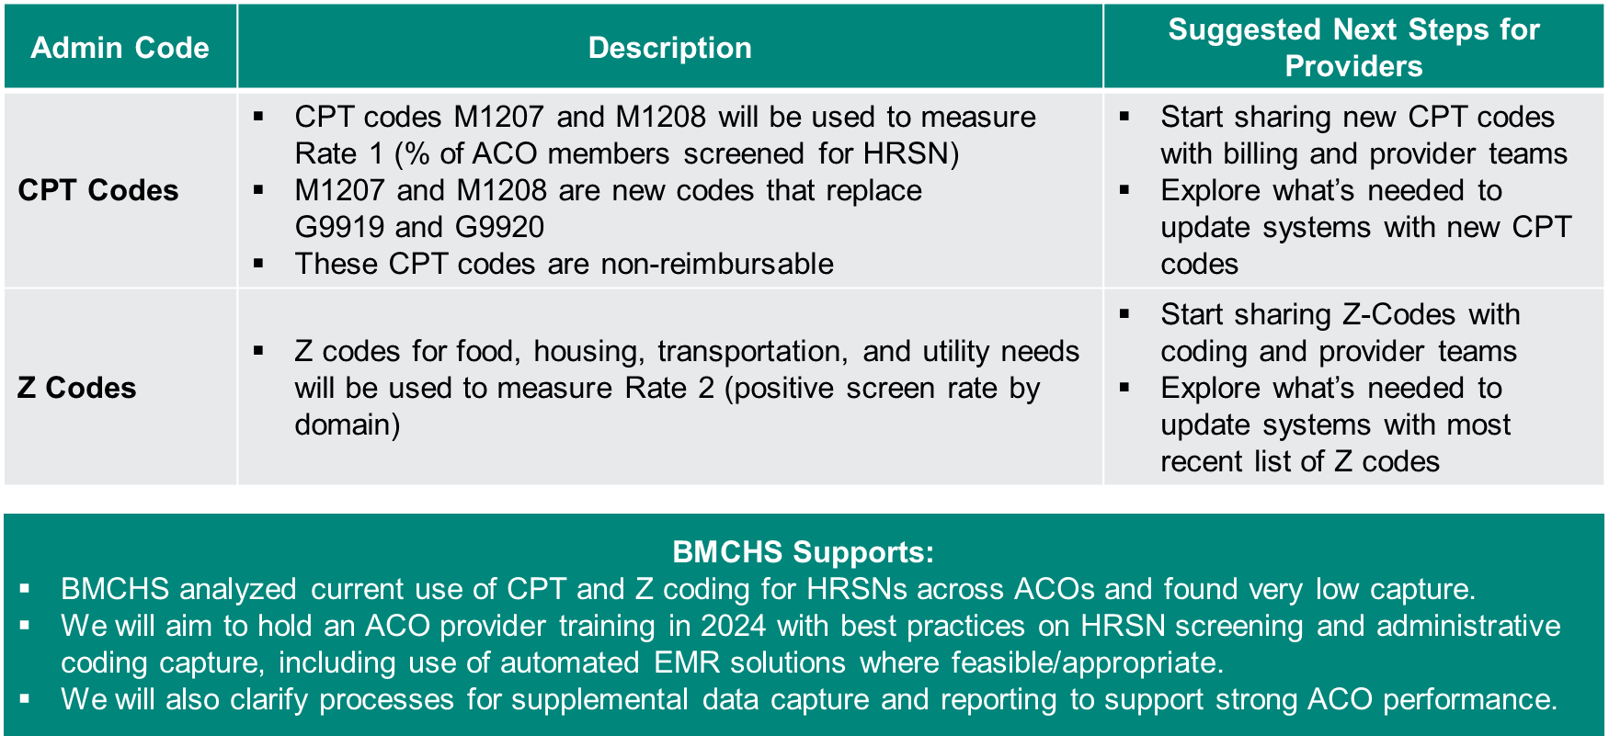
MassHealth Health Equity HRSN Reporting
M1207: Member screened for food insecurity, housing instability, transportation needs, and utility difficulties
M1208: Member not screened for food insecurity, housing stability, transportation needs, and utility difficulties because member actively opted out of screening -OR- member was unable to complete the screening and have no legal guardian or caregiver able to do so on their behalf.

Slide 18
MassHealth Health Equity HRSN Reporting

Slide 19
MassHealth 1115 Waiver Language Access Self-Assessment
Dan Curley – Program Manager, BILH Medicaid ACO's
Nicole DiGirolamo – BILHPN Manager of ACO Programs

Slide 20
Health Equity and Language Access
The WellSense with BILHPN ACO is being asked to perform a self-assessment of our practices to provide MassHealth information and examples on access to language services. This assessment is broken down into four (4) key categories. We are including an example question as well:
Infrastructure and Resources
A) How is staff trained on utilizing language assistance services?
Identifying the Patient’s Preferred Language
A) How are patients informed about language assistance services?
Providing Language Assistance Service Materials
A) This is not relevant to the practices
Competency of Staff Providing the Language Services
A) How do the practices staff interpreters?
Process
BILHPN Central has been able to provide responses on approximately 50% of the survey. We reached out to some of the risk groups in October of 2023 to gather information on the Disability Competency Survey, and we’d like to reach out to the same groups for a very brief 30 minute survey to see if and how these are being done at the practice level. It is okay if these are not being done as we are providing an aggregate response to WellSense and some of these are covered by WellSense.
We are looking at how broadly we are providing these at the practice as well as the ACO level.

Slide 21
Health Equity and Language Access
Questions
Does your organization have a dedicated language services department, function, or area? If yes, please describe where the language services department fits within your organizational structure and the number of FTEs allocated to the department/function/area, including but not limited to staff interpreters, translation services, and administration.
Please describe how language services are administered at your organization (e.g., oversight of qualified interpreters and translators, coordinating requests for in-house or contracted interpretation and translation services, training staff on how to utilize language assistance services when serving members, assessment and improvement of the language services program).
Please list and describe the organization’s internal and external activities to ensure members are informed about the availability of language services (e.g., notices posted in the reception area and/or in examination rooms, call centers, on the organization’s website, etc.)
Please describe how your organization collects self-reported data from members on their preferred spoken and written language(s) for health care. Specifically, describe how and when members are invited to provide such data, in what setting(s), and any instruments used for collection. Please note, if any, differences in the processes for collecting self-reported data for preferred spoken and written language.
Please describe how your organization documents and communicates a member’s language preference to clinical and non-clinical staff that may interact with the member.
Does your organization provide translated written materials into other languages to members? If yes, please describe any policies that govern when and which written materials are translated (i.e. for documents that contain information that is critical for obtaining services and/or benefits such as application forms, consent forms, release of information, complaint forms, eligibility forms, etc).
How does your organization, and/or the organization(s) that you contract with for interpreter services, define competency for language access service providers?

Slide 22
Health Equity and Language Access
Questions (Cont)
How does your organization, and/or the organization that you contract with for interpreter services, ensure language access service providers are sufficiently competent to deliver services?
If multilingual staff and providers are used to meet language access service needs, does your organization have polic(ies) in place to assess staff and provider fluency and ensure that they are sufficiently competent? If yes, please describe the policy and process(es).
Does your organization collect feedback on members’ experience with language access services? Does your organization collect feedback from providers on their experience with language access services? Please describe
Questions? Email Nicole.DiGirolamo@lahey.org and dcurley1@bidmc.harvard.edu

Slide 23
Closing

Slide 24
Follow Up & Tiering Resources
BILHPN Website – Tiering Page
Next MassHealth Tiering Office Hours:
Thursday Jan. 25th @ 1PM – Zoom Link
Agenda: Tiering Updates for 2024, MassHealth Quality Metrics
MH Tiering Update Emails – If you or a colleague need to be added to the email list, please contact Kat or Alanna.
Tiering Question Form– For specific topics to be covered at Office Hours, submit questions to the Microsoft Form at any time.
For questions, please contact Alanna Daley (alanna.m.daley@lahey.org) and Kat Koch (Katerina.koch@lahey.org)

